Slide 1
EXECUTIVE PRESENTATION
THE HUMAN HAND
AND THE INTELLIGENT TOOL
Humanity, innovation, worker dignity, and the moral architecture of amplified effort.
Use innovation to make people more capable, not merely less necessary.
By Chris White | May 2026
The Human Hand and the Intelligent Tool
May 2026 | 1
Notes:
Open with the central thesis: the question is not whether tools do work. The question is whether the use of tools deepens human capability or merely makes people less necessary.

Slide 2
CORE PROPOSITION
PROTECT DIGNITY, NOT REDUNDANCY
The goal is not to keep people busy. The goal is to help people become more.
Eliminate unnecessary toil, not necessary people.
PROTECT WORKERS
BUILD LADDERS
SHARE GAINS
Do not preserve obsolete workflows as a substitute for human development.
If a task changes, the person should have a path to change with it.
Efficiency creates a surplus. Leadership decides where it goes.
The Human Hand and the Intelligent Tool
May 2026 | 2
Notes:
This slide is the frame for the entire deck: dignity is not the same thing as redundancy, and efficiency is not a moral endpoint. It is the beginning of a distribution question.

Slide 3
THE FALSE CHOICE
EFFICIENCY VERSUS EMPLOYMENT IS THE WRONG DEBATE
A better frame is dignity versus redundancy.
BAD BINARY
BETTER FRAME
Embrace efficiency
and accept displacement
Protect dignity.
Remove redundancy.
or preserve old work at any cost
Preserve agency, not needless toil.
Work has dignity because the worker has dignity.
The Human Hand and the Intelligent Tool
May 2026 | 3
Notes:
The treatise rejects both easy positions: anti-technology nostalgia and blind efficiency worship. The moral subject is the worker, not the workflow.

Slide 4
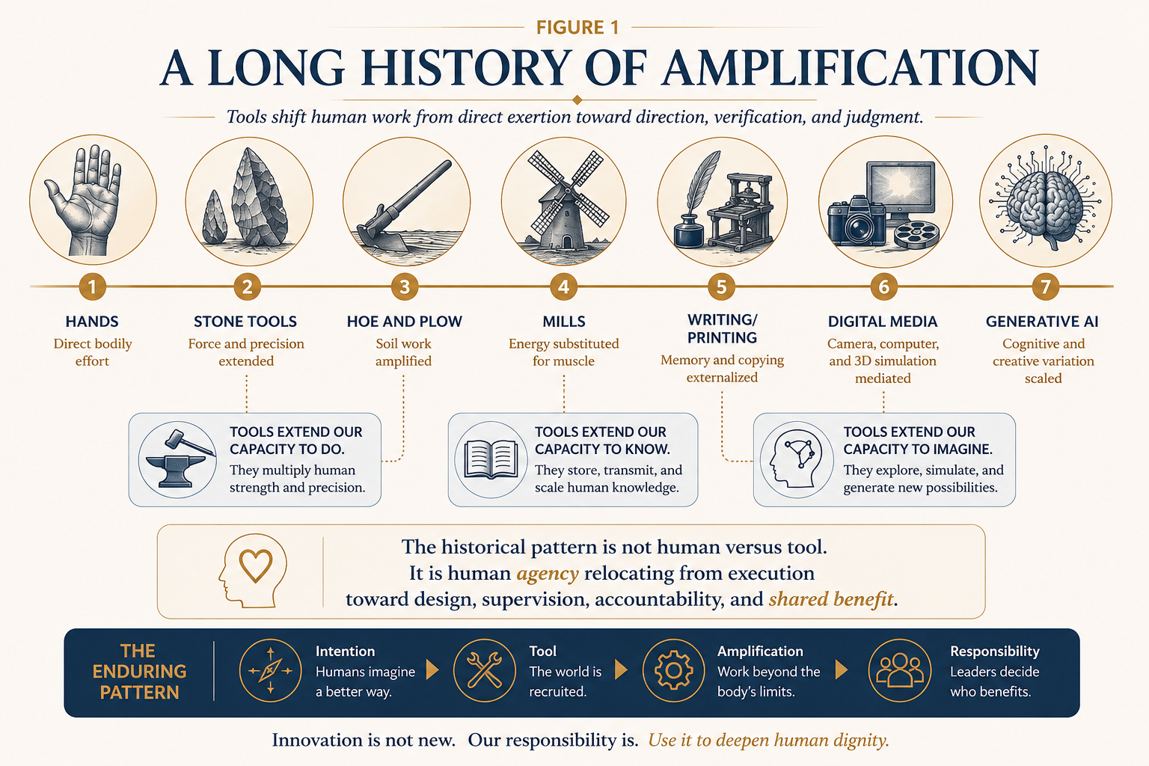
Notes:
Walk the room through the continuity: tools relocate human effort from direct exertion toward direction, verification, and judgment.

Slide 5
HISTORICAL PATTERN
INNOVATION RELOCATES HUMAN AGENCY
The human has not disappeared. The human has moved.
1
2
3
4
Muscle
Direction
Supervision
Judgment
Direct bodily effort is amplified by tools.
The human defines purpose and constraints.
The human oversees systems and corrects drift.
The human owns meaning, accountability, and choice.
The moral question is whether the new human position is freer, wiser, more accountable - or merely more dependent.
The Human Hand and the Intelligent Tool
May 2026 | 5
Notes:
This is the philosophical core: tools do not simply replace people; they change where people stand in the system. Leadership must evaluate whether the new posture improves agency.

Slide 6
DIGNITY DISTINCTION
THE WORKER IS NOT THE WORKFLOW
Routine work can be real work. Redundant work should not become a permanent place.
Baseline work is real work.
Baseline people are not a thing.
Routine tasks can require memory, care, discipline, judgment, and pride.
Preserving a person in a low-growth role can sound humane while quietly protecting hierarchy.
Reject contempt for ordinary work.
Reject benevolent containment.
The dignity belongs to the worker. The redundancy belongs to the system.
The Human Hand and the Intelligent Tool
May 2026 | 6
Notes:
This slide should be delivered plainly. The goal is not to degrade routine work; it is to refuse to trap people in routine work because the system has not designed a better path.

Slide 7
OPERATIONAL FRAME
JOBS ARE BUNDLES; EFFICIENCY CREATES A SURPLUS
Automation disturbs tasks first, then roles, wages, training, status, and power.
A JOB IS NOT
A SOLID OBJECT
Tasks
Training
Status
Income
Relationships
Risk
It is a bundle of tasks, permissions, relationships, risks, training functions, status signals, and future opportunities.
When the tool saves time, the surplus will go somewhere.
Margin | Training | Wages | Lower price | Quality | Workload | Layoffs
The Human Hand and the Intelligent Tool
May 2026 | 7
Notes:
A job contains more than tasks. A task can be removed while a training function or status function remains unaccounted for. Efficiency creates surplus, and surplus allocation is a moral choice.

Slide 8
MANAGEMENT TEST
THE TIME DIVIDEND IS NEVER NEUTRAL
Tools do not decide where savings go. Leaders do.
The moral test of innovation is not whether it saves time.
It is what the organization does with the time it saves.
Margin
Training
Wages
Quality
Workload
ownership benefit
capability benefit
worker benefit
client benefit
human benefit
The Human Hand and the Intelligent Tool
May 2026 | 8
Notes:
Use this slide to invite the room to name the default allocation in their own organization. Does the time saved become capability or simply extraction?

Slide 9
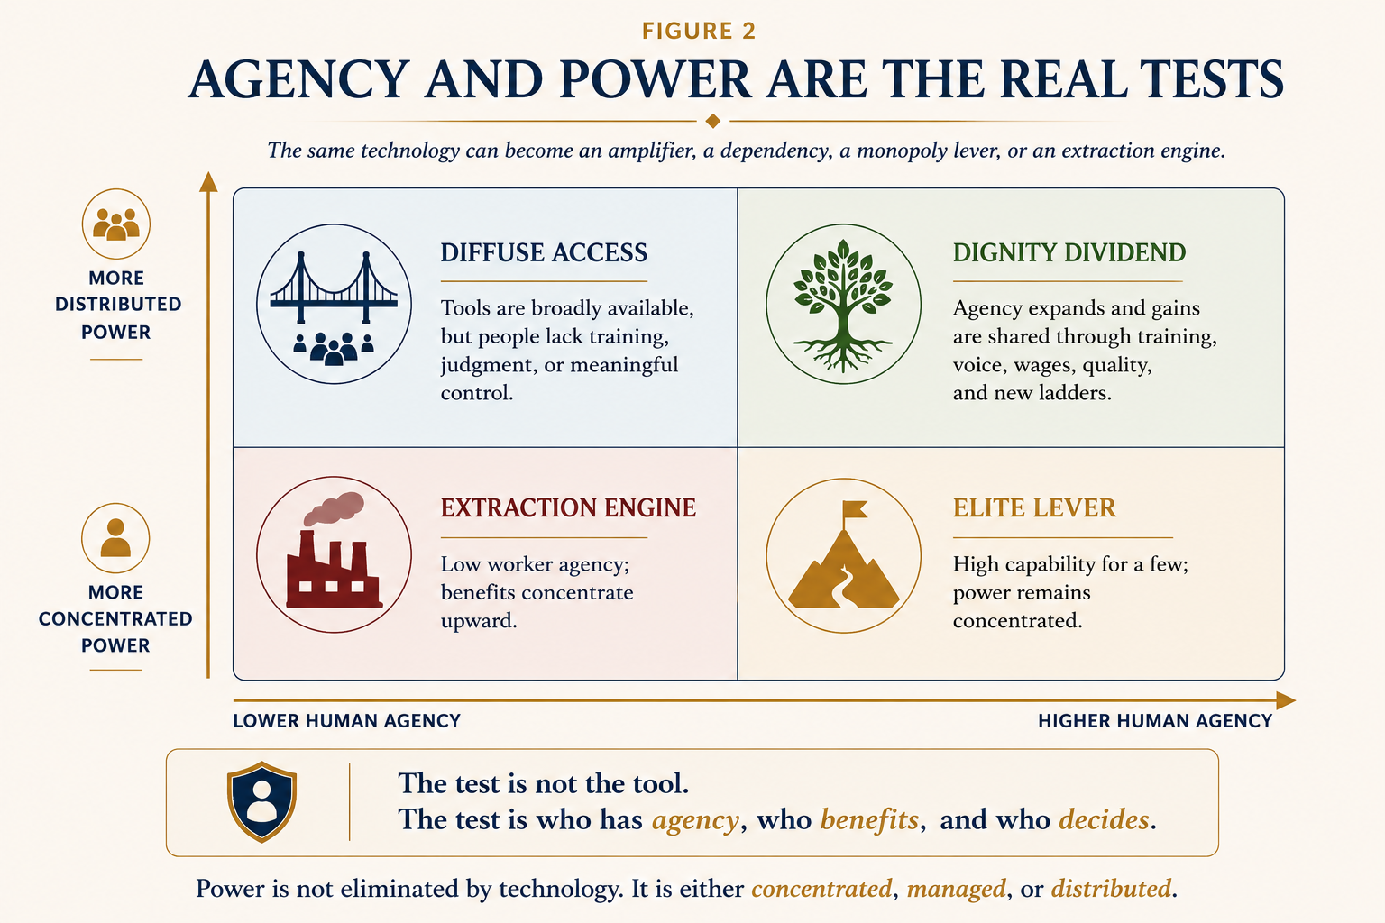
Notes:
The same technology can become an amplifier, a dependency, a monopoly lever, or an extraction engine. The test is not the tool; it is agency and power.

Slide 10
MORAL USE OF TECHNOLOGY
THE SAME TOOL CAN SERVE THREE DIFFERENT ROLES
The surrounding system determines whether the tool expands or narrows human agency.
1
Amplification
2
Delegation
3
Substitution
The tool expands a worker’s ability while the worker remains meaningfully in command.
The tool performs a defined task under trained human supervision and correction.
The tool replaces a role or reduces the human to token oversight.
The moral difference is not only the tool.
It is training, voice, accountability, shared gains, and role design.
The Human Hand and the Intelligent Tool
May 2026 | 10
Notes:
Do not let the organization talk abstractly about AI. Ask which mode is being deployed: amplification, delegation, or substitution.

Slide 11
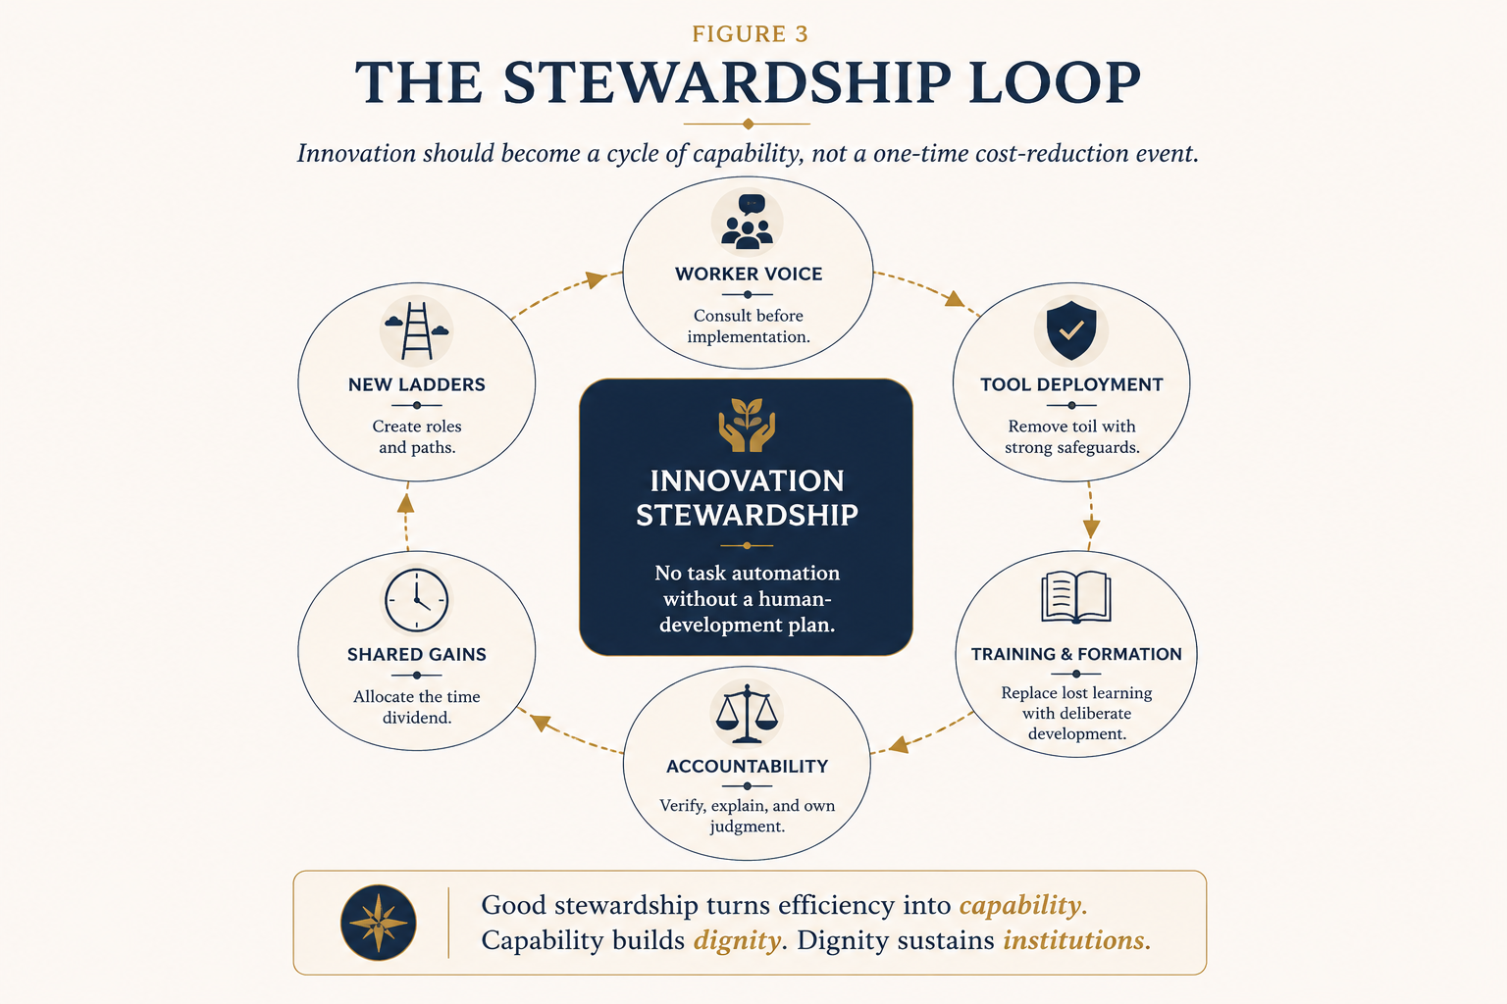
Notes:
Stewardship is a loop, not a launch event: worker voice, safeguards, training, accountability, shared gains, and new ladders.

Slide 12
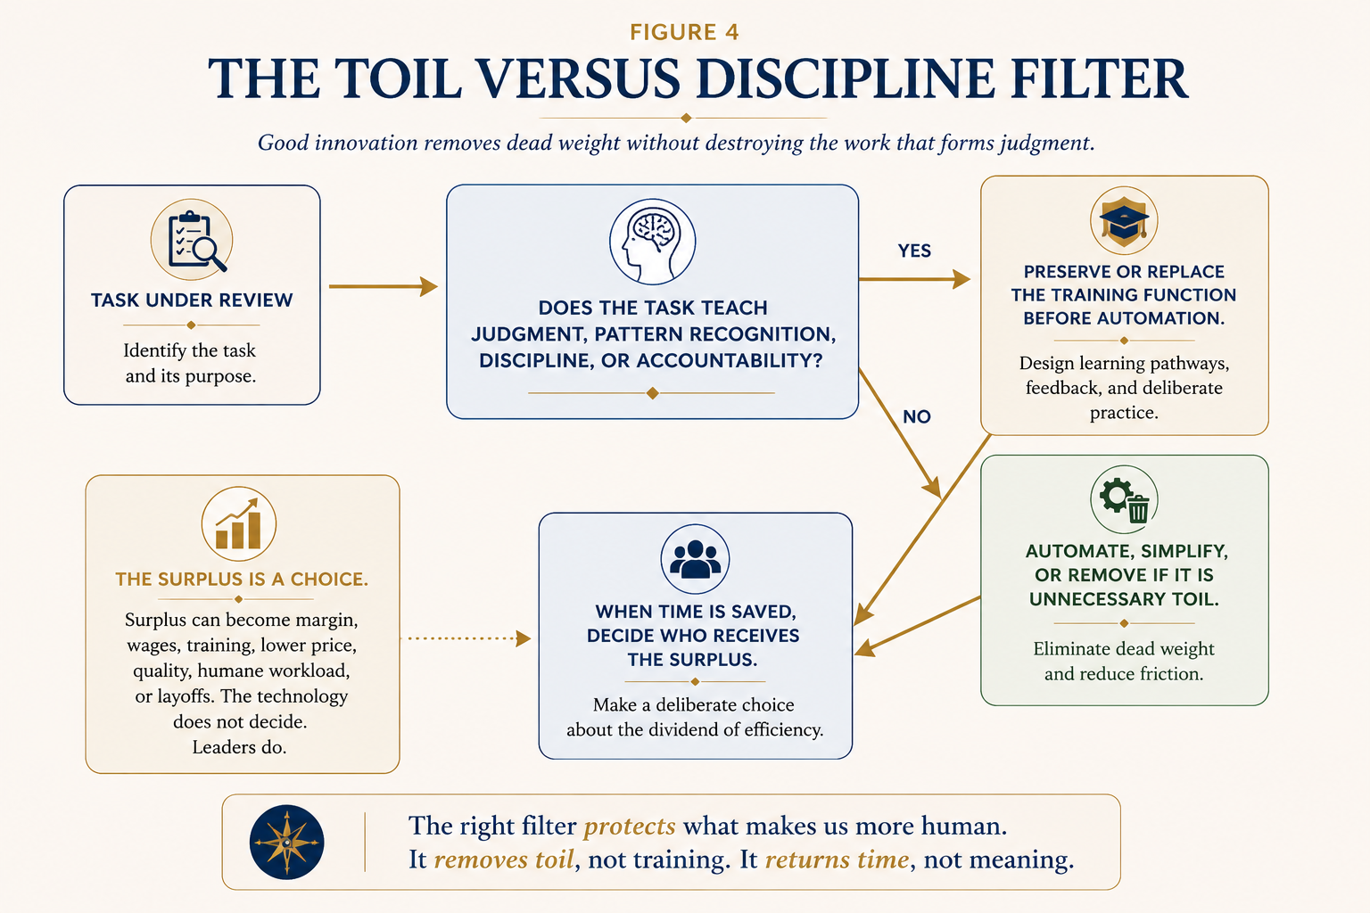
Notes:
This is the practical filter: remove dead weight, not the work that forms judgment. If a task teaches something, preserve or replace that learning before automation.

Slide 13
LIMITS OF THE ANALOGY
AI IS NOT MERELY ANOTHER HOE
The historical analogy defeats the weak objection. It does not settle the strongest objections.
WEAK OBJECTION
STRONGER OBJECTION
“The machine did the work.”
That objection also reaches the hoe, the mill, the press, the camera, the renderer, and the spreadsheet.
Training data, consent, compensation, provenance, opacity, bias, attribution, style imitation, and platform concentration.
Machine assistance does not negate human creativity.
It still must be judged by sourcing, accountability, power, and honest authorship.
The Human Hand and the Intelligent Tool
May 2026 | 13
Notes:
This slide is critical for credibility. The presentation is not saying all AI objections fail. It is saying the mere presence of machine labor is not a coherent objection.

Slide 14
CREATIVE PRODUCTION
3D MODELING AND GENERATIVE AI RAISE THE SAME FIRST QUESTION
The tool category alone does not settle authorship.
3D MODELING
GENERATIVE AI
A rendering engine calculates light, shadow, physics, and material behavior.
A model proposes outputs; humans may prompt, curate, revise, composite, verify, and own.
Accepted when human direction, craft, and accountability remain meaningful.
Legitimate use depends on control, transformation, sourcing, and truthfulness.
The stronger the human intention, control, revision, transformation, accountability, and final judgment, the stronger the authorship claim.
The Human Hand and the Intelligent Tool
May 2026 | 14
Notes:
Use the 3D modeling comparison carefully. It is not that AI and 3D are identical; it is that “the machine did work” cannot be the dividing line.

Slide 15
APPENDIX A
LEADER’S CHECKLIST FOR DIGNITY-PRESERVING INNOVATION
Before a task is automated, simplified, or assigned to a new technical system, leaders should ask better questions.
1
Status
4
Risk
7
Accountability
Is the task unnecessary, or merely lower-status?
What income, status, advancement, or identity risk appears?
Who owns quality, confidentiality, bias, and provenance?
2
Formation
5
Path
8
Budget
What will junior people no longer learn?
What new role or ladder absorbs freed capacity?
What training budget accompanies the tool budget?
3
Voice
6
Dividend
9
Class test
Who performs the task, and were they consulted?
Will gains be shared with workers and clients?
Would we defend this redundancy for a higher-status worker?
No major task automation without a human-development plan.
The Human Hand and the Intelligent Tool
May 2026 | 15
Notes:
Appendix A translates the philosophy into leadership questions. This is a checklist for the moment before a tool or workflow is adopted.

Slide 16
APPENDIX A-1
THE DIGNITY-PRESERVING INNOVATION DECISION TOOL
A practical scorecard, decision record, and human-development plan for proposed workflow change.
1
Necessity & Status
3
Agency & Power
Is the task unnecessary, or merely lower-status?
Who gains control, who loses discretion, and who is consulted?
2
Formation & Learning
4
Surplus & Accountability
Does the task teach judgment, discipline, or accountability?
Who receives the dividend, and who owns final judgment?
The tool is not designed to prevent innovation. It is designed to prevent lazy innovation.
The Human Hand and the Intelligent Tool
May 2026 | 16
Notes:
Appendix A-1 turns the core rule into a repeatable decision instrument. It asks what changes, who is affected, what must be preserved, and where the gains go.

Slide 17
DECISION GATE
HARD-STOP GATES COME BEFORE SCORING
A high score cannot cure a blocked dignity risk.
Affected workers were not consulted.
The change reduces status, income, or advancement without mitigation.
WORKER VOICE
STATUS / INCOME
A training function disappears without a replacement path.
All savings flow upward, with no worker/client/training benefit.
FORMATION RISK
COST EXTRACTION
No named human owns quality, bias, provenance, or final judgment.
Legal, financial, safety, privacy, employment, or client-impacting decisions lack heightened safeguards.
ACCOUNTABILITY
HIGH-STAKES USE
If a hard-stop gate is triggered, pause implementation and redesign the plan before scoring.
The Human Hand and the Intelligent Tool
May 2026 | 17
Notes:
This slide is useful in live governance. A numerical scorecard should never become a way to rationalize unresolved dignity or accountability risk.

Slide 18
SCORECARD
DISCIPLINED DELIBERATION, NOT FAKE MATH
Score each criterion from 0 to 3; hard stops override the numerical score.
1. Necessity vs. status bias
0 1 2 3
6. Shared gains
0 1 2 3
2. Formation value
0 1 2 3
7. Quality & accountability
0 1 2 3
3. Worker voice
0 1 2 3
8. Training budget
0 1 2 3
4. Income/status risk
0 1 2 3
9. Junior learning
0 1 2 3
5. New ladder / role path
0 1 2 3
10. Status test
0 1 2 3
24–30 proceed | 18–23 conditional pilot | 12–17 redesign | 0–11 do not proceed
The Human Hand and the Intelligent Tool
May 2026 | 18
Notes:
The scorecard is intentionally simple. It makes leadership disclose what is planned, funded, worker-informed, and measurable.

Slide 19
REQUIRED ATTACHMENT
HUMAN-DEVELOPMENT PLAN
Every major automation, simplification, or AI-enabled workflow change needs a plan specific enough to be audited.
What changes, who performs it today, and who relies on it?
What role, responsibility, status, or development path absorbs freed capacity?
TASK & ROLES
NEW LADDER
What judgment, learning, quality control, or institutional memory exists?
How will time savings become training, wages, workload relief, quality, or client value?
HUMAN VALUE
SHARED GAINS
How will lost learning be preserved, simulated, mentored, or moved?
Who owns final judgment, confidentiality, provenance, bias review, and escalation?
REPLACEMENT PATHWAY
ACCOUNTABILITY
30 / 60 / 90 days: Did this innovation make people more capable, or merely less necessary?
The Human Hand and the Intelligent Tool
May 2026 | 19
Notes:
The human-development plan is the part that keeps the philosophy from staying abstract. It names affected workers, training, pathways, accountability, and review metrics.

Slide 20
EVIDENCE BASE
SOURCE NOTES ANCHOR THE ARGUMENT; THEY DO NOT OVERCLAIM THE FUTURE
The full bibliography remains in the companion thought piece.
HISTORICAL & PHILOSOPHICAL
LABOR & INSTITUTIONS
Tool extension, writing as technology, mechanical reproduction, digital craft, artifacts and power.
Automation, task exposure, skill change, job quality, worker consultation, training, and public-workforce readiness.
AI LAW & AUTHORSHIP
INTERPRETATION CAUTION
Human authorship, AI-assisted works, training data, fair use, consent, compensation, and provenance.
Exposure, capability, and time savings are not predictions of actual job loss for any specific worker or firm.
The Human Hand and the Intelligent Tool
May 2026 | 20
Notes:
This slide prevents the deck from overstating the evidence. Labor-market projections are treated as exposure estimates and institutional assessments, not as deterministic forecasts.

Slide 21
FINAL SYNTHESIS
USE MACHINES TO REMOVE MACHINE-LIKE TOIL
Then build human systems around judgment, relationship, creativity, responsibility, care, courage, taste, and wisdom.
Use innovation to make people more capable, not merely less necessary.
THE MACHINE MAY DO MORE OF THE WORK.
THAT ONLY MAKES THE HUMAN QUESTION MORE IMPORTANT.
Protect dignity. Build ladders. Share gains. Preserve formation. Own judgment.
The Human Hand and the Intelligent Tool
May 2026 | 21
Notes:
Close by returning to the thesis. The deck is not anti-technology. It is anti-lazy innovation and pro-human capability.

