Slide 1
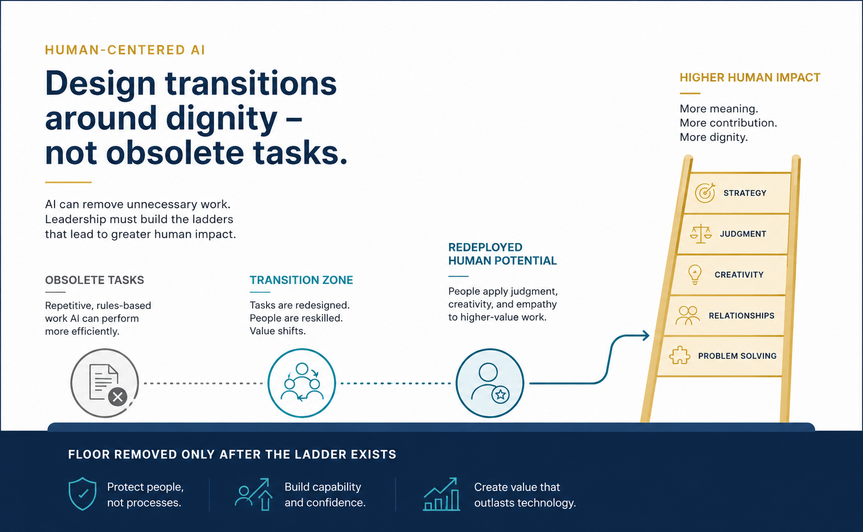
EXECUTIVE THOUGHT PIECE
Dignity
Is Not
Redundancy
How leaders should rethink AI, work, and the jobs they think they are saving.
Protect dignity, not redundancy.
Build ladders before removing floors.
By Chris White | May 2026
Notes:
Opening frame: AI is not the subject. Human dignity is. The leadership question is not whether AI removes work; it is what we build for people when it does.

Slide 2
THE FRAME
The false choice is the wrong choice
The debate is usually framed as efficiency versus employment. The better frame is dignity versus redundancy.
×
Bad frame
✓
Better frame
→
Leadership work
“Either embrace efficiency and accept displacement, or defend jobs by preserving work technology can perform.”
Protect workers, not obsolete workflows. Preserve dignity, not redundant tasks.
Build roles, training, compensation, and status around the human capability AI makes possible.
Baseline work is real work. Baseline people are not a thing.
Dignity Is Not Redundancy
Executive Thought Piece | May 2026
Notes:
This slide establishes the core reframing. Job preservation may sound humane, but it can also freeze people in low-growth roles. The goal is to protect people, not preserve inefficiency.

Slide 3
IDEA IN BRIEF
Four moves leaders need to make
AI adoption without human development is not a strategy. It is only cost extraction.
1
THE PROBLEM
2
THE TRAP
AI can remove baseline tasks faster than organizations can redesign roles, training, compensation, and status.
Defending jobs by preserving redundancy can sound humane while quietly keeping people in low-growth positions.
3
THE ARGUMENT
4
THE MOVE
Work has dignity because the worker has dignity. Redundant work does not become dignified merely because a person is required to keep doing it.
Attach every AI adoption plan to a human-development plan: voice, training, shared gains, new ladders, and formative work.
Operational test: No AI task automation without a human-development plan.
Dignity Is Not Redundancy
Executive Thought Piece | May 2026
Notes:
The deck moves from moral frame to evidence to leadership design. The throughline is simple: efficiency creates a surplus; leaders decide whether that surplus creates dignity.

Slide 4
Human-Centered AI
Executive Thought Piece | May 2026
Notes:
This image carries the central metaphor: remove the floor only after the ladder exists. AI can remove unnecessary tasks, but leadership must build the transition zone and higher human impact.

Slide 5
THE MORAL FOUNDATION
The dignity of work is not the dignity of inefficiency
Work matters because workers matter. It structures time, conveys belonging, forms skill, supports families, and allows people to contribute.
The principle cuts both ways:
Respect routine work.
Refuse to romanticize redundancy.
LEADERSHIP DISTINCTION
The dignity belongs to the worker.
The redundancy belongs to the system.
Publication note: The source article grounds this in USCCB social teaching and John Paul II’s Laborem Exercens.
Notes:
The point is not to treat routine work as lesser. It is to avoid confusing the worker’s dignity with a system’s failure to create better paths.

Slide 6
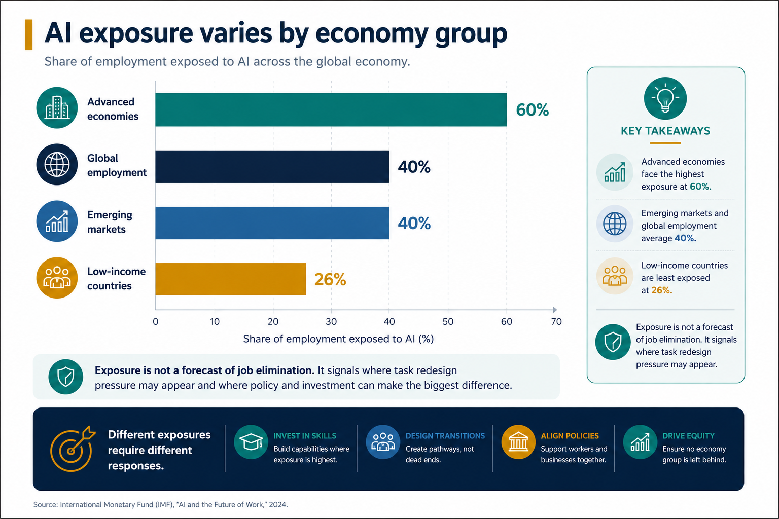
Evidence: Exposure Is Not Destiny
Executive Thought Piece | May 2026
Notes:
IMF exposure data is not a forecast of elimination. It shows where task redesign pressure may appear and where investment, skills, and policy responses matter.

Slide 7
THE EVIDENCE
Exposure is not destiny
The responsible reading is neither panic nor complacency. AI changes tasks first; jobs and power follow.
A job is not a solid object. It is a bundle of tasks, responsibilities, relationships, permissions, and expectations.
1
Tasks shift
2
Power shifts
3
Design matters
AI may remove one portion of the job while making another portion more important.
Automation changes training needs, bargaining power, margins, and role expectations.
The failure is not adopting AI. The failure is adopting it without redesigning human contribution.
The technology does not decide. Leaders do.
Dignity Is Not Redundancy
Executive Thought Piece | May 2026
Notes:
This is the pivot from statistics to leadership. The data does not determine the outcome. Institutions decide how freed capacity, cost savings, and changing roles are allocated.

Slide 8
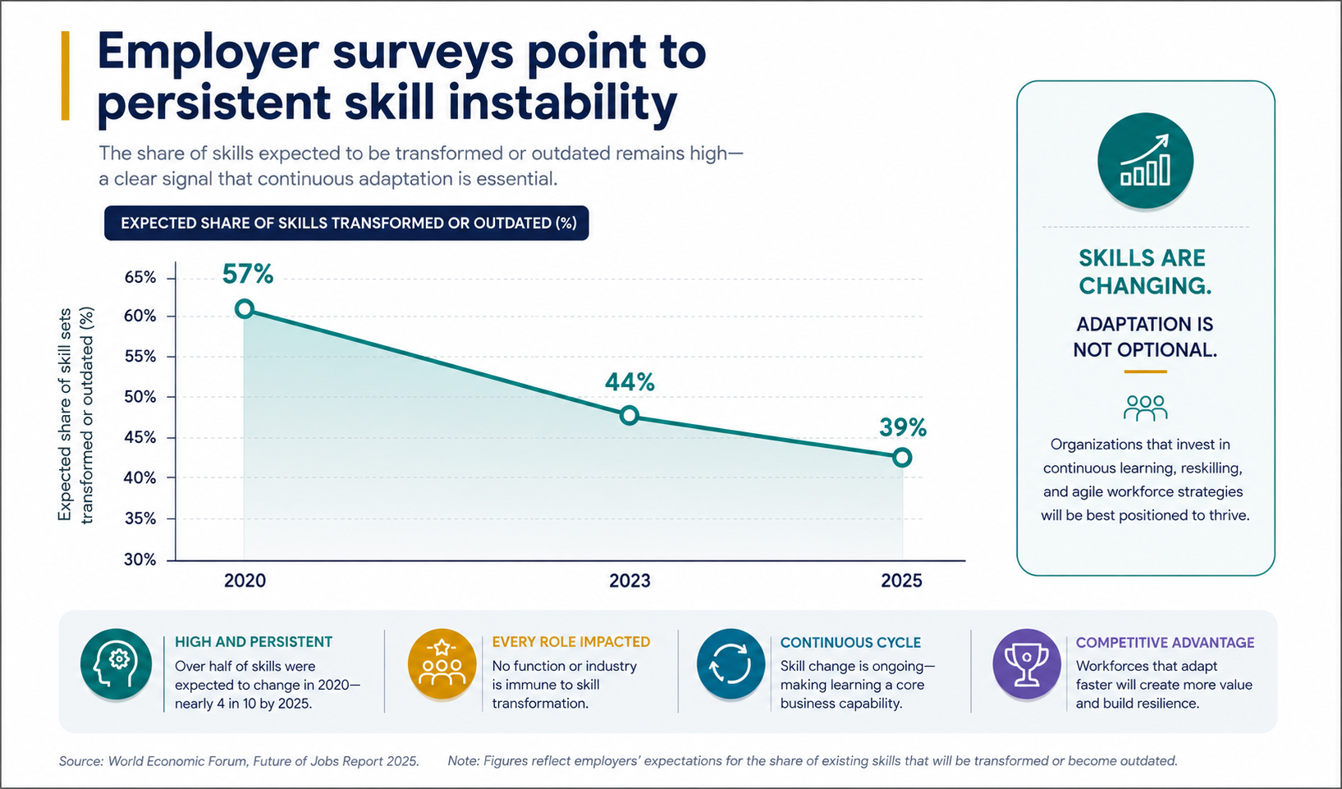
Evidence: Skill Instability
Executive Thought Piece | May 2026
Notes:
WEF employer survey data shows that expected skill change remains material even though the number has declined from prior surveys. Treat this as a training infrastructure argument, not a panic argument.

Slide 9
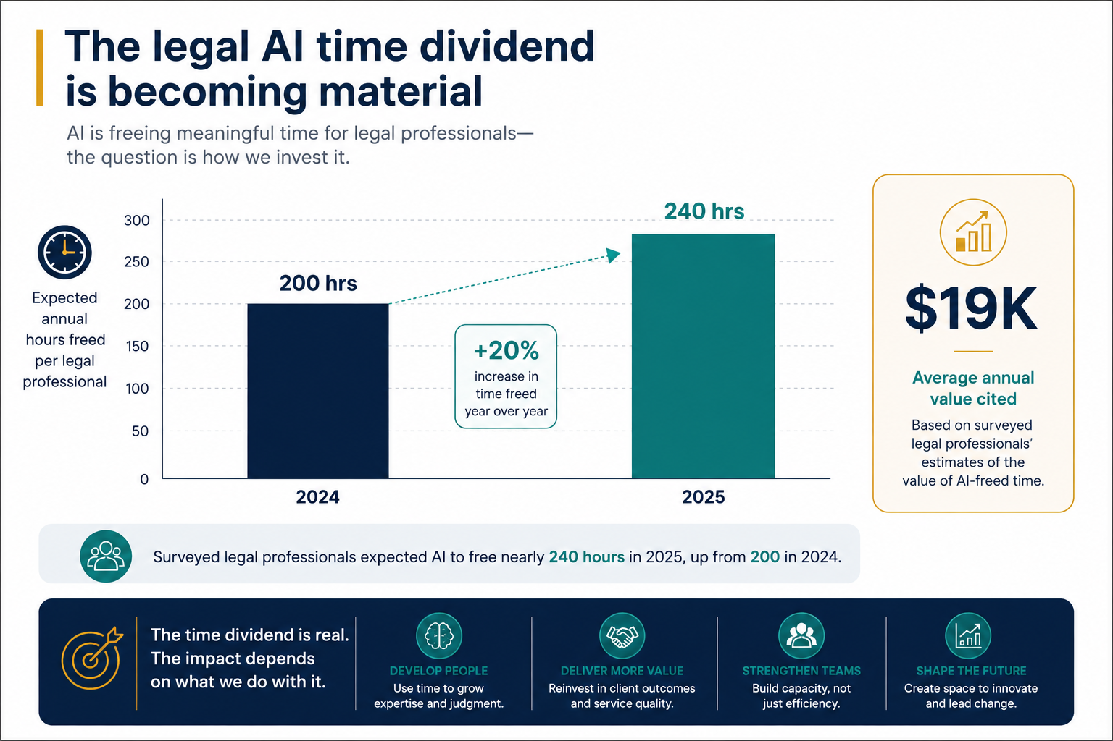
Evidence: Legal Time Dividend
Executive Thought Piece | May 2026
Notes:
In legal services, surveyed professionals expect a real time dividend. The decision is what that time becomes: margin, training, client value, humane workload, or headcount reduction.

Slide 10
THE HIDDEN ASSUMPTION
When “saving jobs” can become class-coded
The question is whether we are protecting people — or preserving a familiar social arrangement.
“They are good at that work” can mean two very different things:
✓
Humane version
!
Dangerous version
They have skill, preference, and dignity in work that is predictable, concrete, or detail-oriented.
Their current assignment is treated as their ceiling — “that is their place.”
STATUS TEST
Would we be satisfied if our own child were permanently assigned the role because “that is what they are good at”?
Dignity Is Not Redundancy
Executive Thought Piece | May 2026
Notes:
This slide is deliberately careful. The article does not accuse the opposing lawyer of classism. It tests whether the argument risks converting present position into presumed destiny.

Slide 11
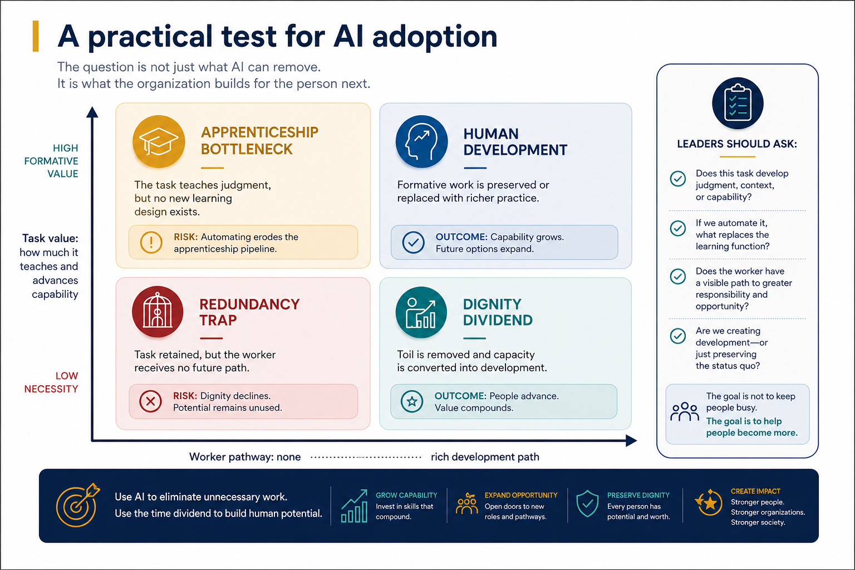
Decision Framework
Executive Thought Piece | May 2026
Notes:
Use the matrix as a practical audit. High formative value plus no redesign creates an apprenticeship bottleneck. Low task value plus no pathway creates the redundancy trap. The goal is the dignity dividend.

Slide 12
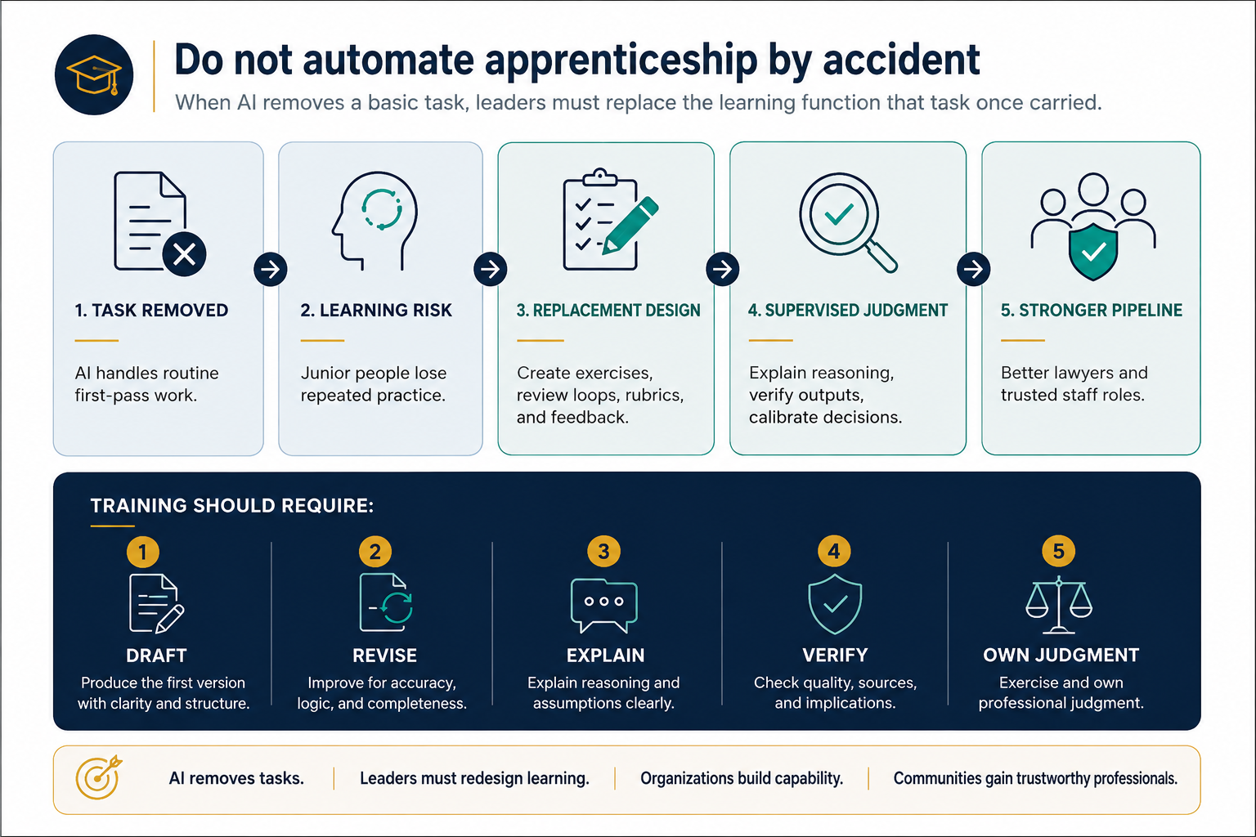
Case Study: Law
Executive Thought Piece | May 2026
Notes:
The five-step sequence turns AI adoption into professional formation: draft, revise, explain, verify, own judgment. This preserves apprenticeship without preserving needless toil.

Slide 13
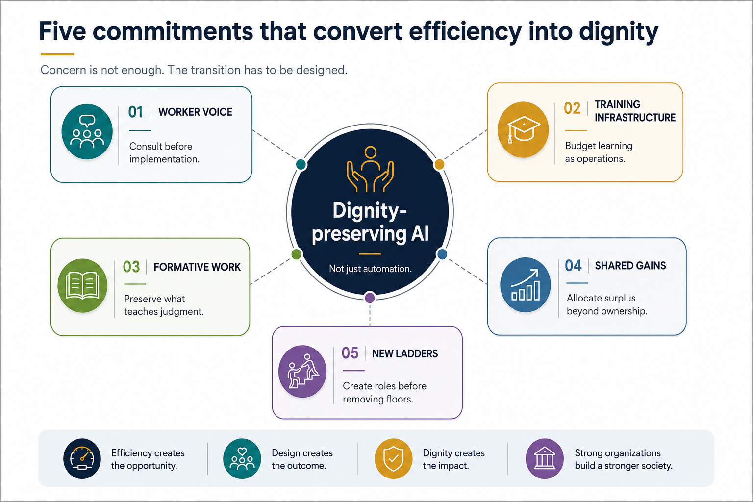
Dignity-Preserving AI
Executive Thought Piece | May 2026
Notes:
The five commitments are the heart of the operating model: worker voice, training infrastructure, formative work, shared gains, and new ladders.

Slide 14
LEADER’S CHECKLIST
Before AI replaces a task, ask better questions
The goal is not to keep people busy. The goal is to help people become more.
1.
Is the task unnecessary, or merely lower-status?
6.
Will productivity gains be shared with workers and clients — or only ownership?
2.
Does this task teach judgment, pattern recognition, or professional discipline?
7.
How will quality, confidentiality, bias, and accountability be supervised?
3.
Who performs the task, and have they been consulted?
8.
What training budget accompanies the tool budget?
4.
What income, status, or advancement risk does automation create?
9.
What will junior people no longer learn if this task disappears?
5.
What new role or development path will absorb the freed capacity?
10.
Would we defend this same redundancy if done by someone with higher status?
Operational rule: No AI task automation without a human-development plan.
Dignity Is Not Redundancy
Executive Thought Piece | May 2026
Notes:
This is the practical operating checklist. It converts the moral argument into management behavior. The line is not anti-AI. It is anti-unplanned displacement.

Slide 15
A BETTER PRINCIPLE
Eliminate unnecessary toil —
not necessary people.
Protect dignity, not redundancy.
Build ladders before removing floors.
AI may force organizations to confront a truth that was already present: many economic systems were built to allocate labor, not protect dignity.
The real disruption is moral.
Notes:
Close with the core principle. The goal is not to freeze the economy in place or to charge forward blindly. It is to use the time dividend and task shift to deepen human dignity.

Slide 16
APPENDIX
Source base and interpretation cautions
Forward-looking labor-market claims are treated as estimates or survey findings, not certainties.
USCCB
“The Dignity of Work and the Rights of Workers.”
Brookings
“Research on AI and the labor market is still in the first inning” (2026).
John Paul II
Laborem Exercens (1981).
World Economic Forum
Future of Jobs Report 2025 digest.
ILO
“Generative AI likely to augment rather than destroy jobs” (2023).
Thomson Reuters
Future of Professionals Report 2025.
IMF
“AI Will Transform the Global Economy…” and Gen-AI Staff Discussion Note (2024).
Thomson Reuters Institute
“Legal training in the age of AI” (Apr. 30, 2025).
OECD
“AI and work” and AI workplace survey findings.
American Bar Association
Formal Opinion 512 announcement (July 29, 2024).
Yale Budget Lab
“Tracking the Impact of AI on the Labor Market” (Apr. 16, 2026).
David H. Autor
“Why Are There Still So Many Jobs?” Journal of Economic Perspectives 29(3), 2015.
Chart caution: exposure, skill change, and time savings are not job-loss forecasts. They identify where transition design is needed.
Dignity Is Not Redundancy
Executive Thought Piece | May 2026
Notes:
Source slide for credibility. The core claims are based on institutional, primary, or widely cited peer-reviewed sources.

